Slide 1
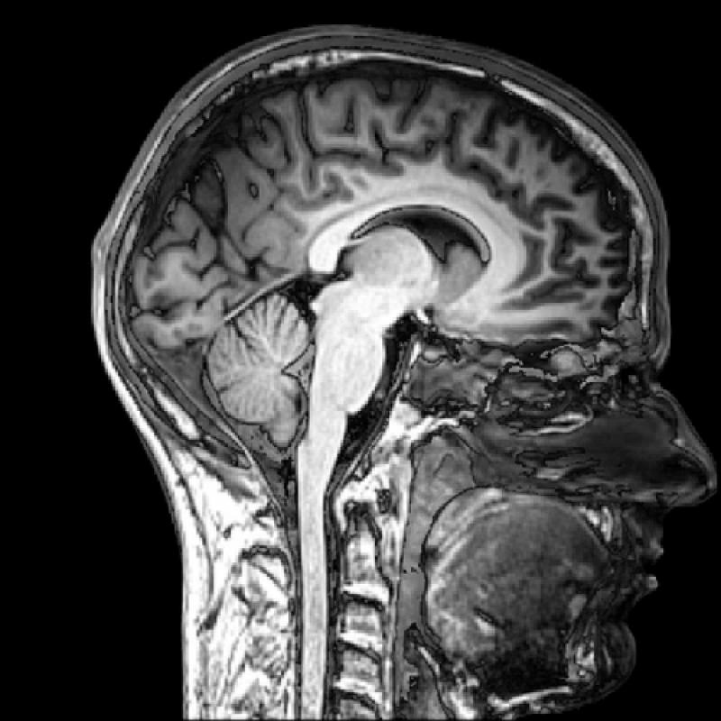
Modern imaging techniques in biology
The physical background of medical tomographies
Lecture 5

Slide 2
MRI thematics
Microscopic and macroscopic magnetization. The Bloch equation. T₁ and T₂ relaxation times.
Magnetic resonance. 90° pulse. FID: free induction decay. Effective T₂.
Pulse method for determining T₂ and T₁. Spin echo. Magnetic resonance spectroscopy.
Imaging. Selective excitation and read out of a slice.
Pulse sequences and contrast. Flow in MRI.
fMRI. BOLD. Echo planar imaging (EPI). Spin echo (SE) and gradient echo (GE) for fast imaging.

Slide 3
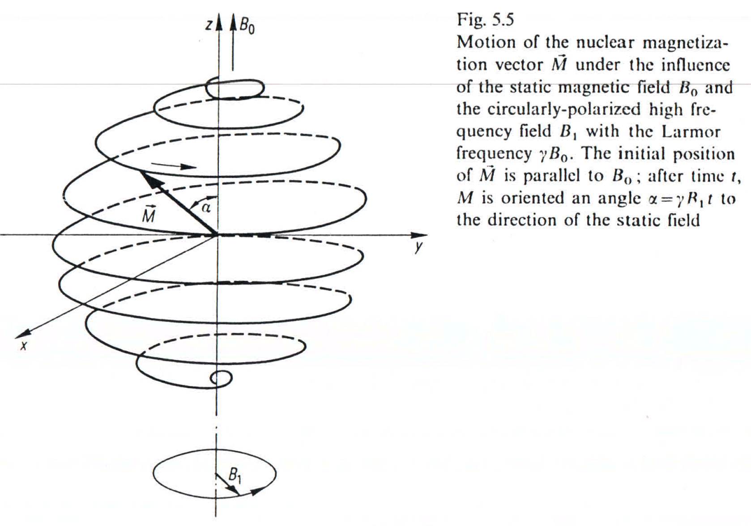
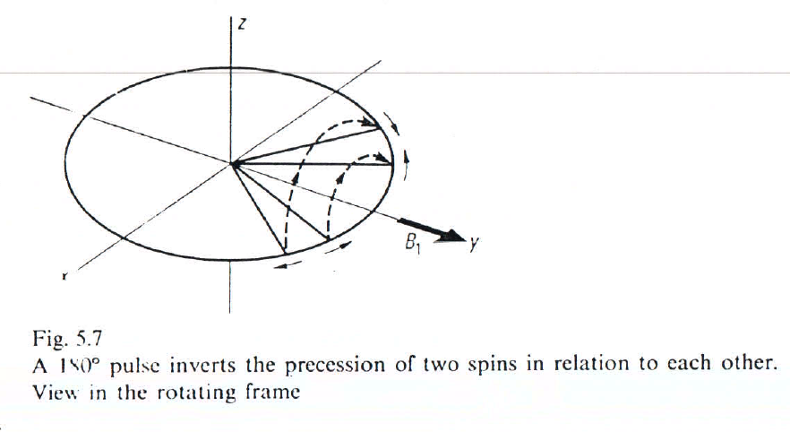
Pulse method for determining T₂
180° pulse can reverse the delay between the slower and faster rotating spins. (Reversible relaxation.)

Slide 4
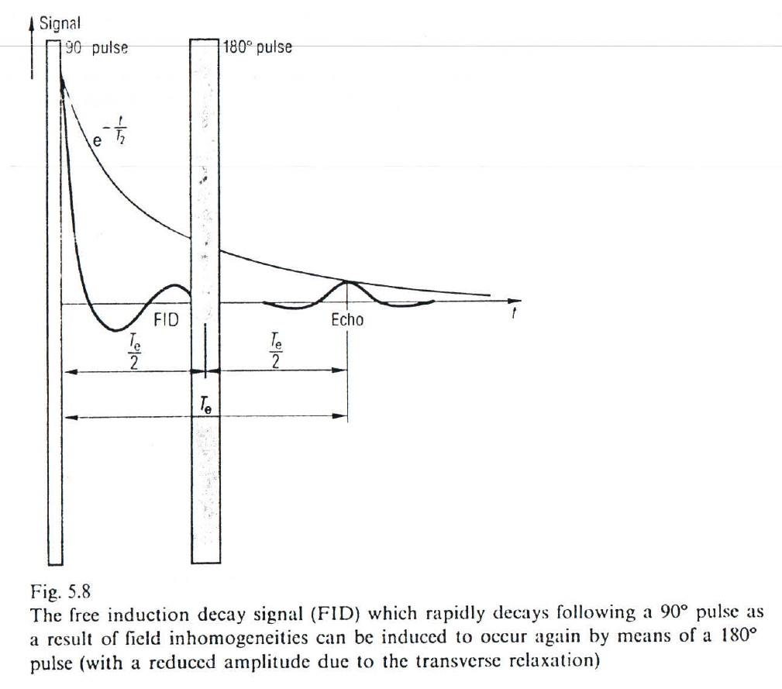
Spin echo
An echo signal appears after the spins are focused again as a result of the 180° pulse.

Slide 5
Effect of molecular diffusion on the spin echo
Beside T₂ the amplitude of the spin echo is effected also by the diffusion of molecules in the magnetic field gradient especially in liquids.
$$Me\left(Te\right)=M0e^{−\frac{Te}{T2}−\frac{Dγ2G2Te3}{12}}$$
D: diffusion coefficient, G: magnetic field gradient. Thus beside T₂, D also can be measured
Source: Youtube

Slide 6
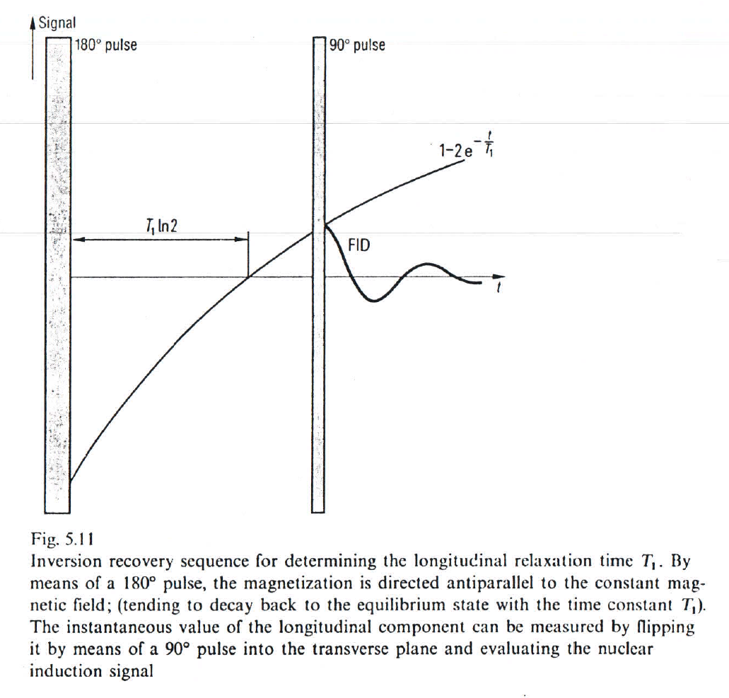
Pulse method for determining T₁
Inversion recovery.
$$Mz\left(t\right)=M0(1−2e^{−\frac{t}{T1}})$$

Slide 7
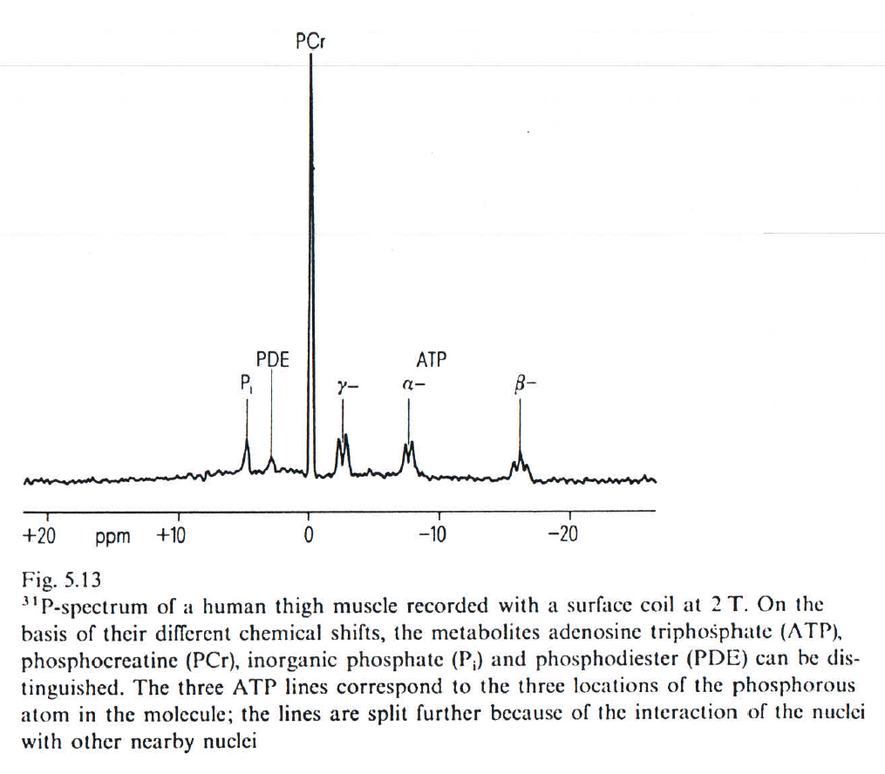
Magnetic resonance spectroscopy
Chemical shift $(δk$): molecular electrons responsible for chemical bonds screen the external magnetic field:
$$Bk=B0−δkB0$$
B_{k}: magnetic field experience by the atomic nucleus.

Slide 8
Fine splitting of magnetic resonance lines

Slide 9
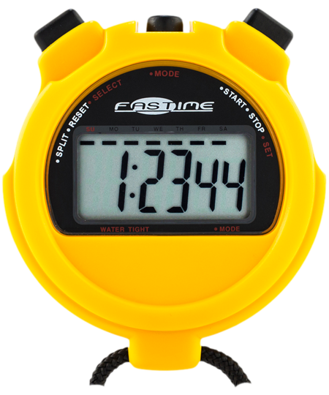
Imaging procedures and measurement times
Spatial information is coded into the signal by superimposing magnetic field gradients onto the static B₀ both during excitation and read-out.
The object to be image is virtually devided into N³ volume elements (voxels). If voxels are measured point-by-point (one by one), the time need is proportional to N³.
It is also possible to measure the signal from a whole row simultaneously. Then the measurement has to be repeated N times under different conditions to calculate the contribution of each voxels. Measurement time thus remain the same but signal-to-noise ratio is improved by a factor of $\sqrt{N}$.
This concept can be extended to scanning surfaces or volumes simultaneously.

Slide 10
Planar scanning is faster
In spite of the good signal-to-noise ratio scanning by volume is usually not adventageous as T₁ and T₂ relaxation times limit the repatition rate of measurements (excitations).
Typically within T₂ only N measuring points can be scanned. We need to wait ~T₁ between excitations to let the spins relax. It results in N²T₁ total measurement time when scanning by volume.
For planar scaning NT₁ is enough for the whole object because further slices can be measured in the relaxation pauses.

Slide 11
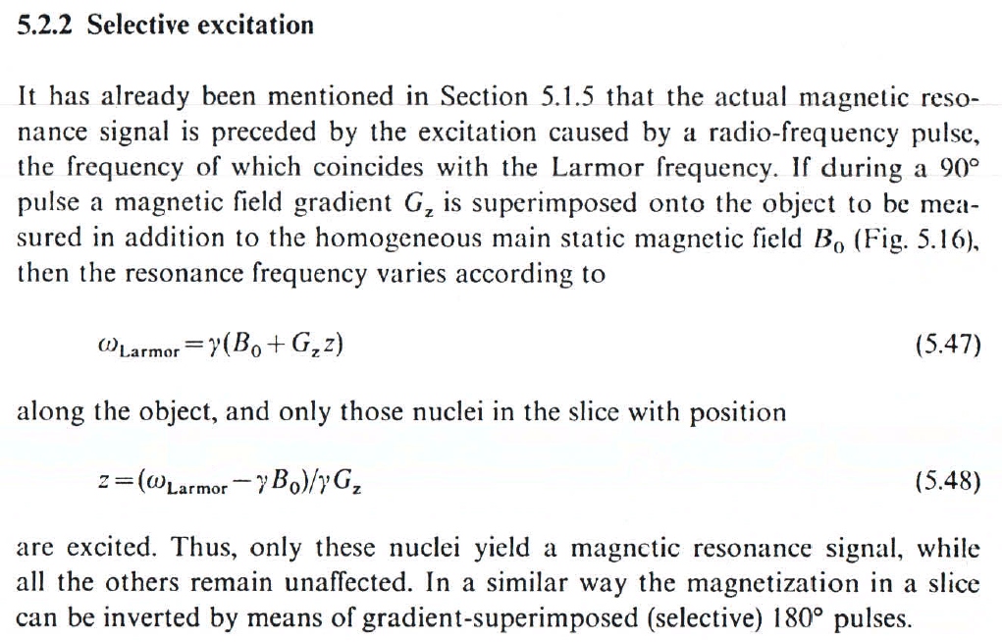
Remark
Surface coils can also be applied to receive RF signal only from the subregion of interest. Advantage: increased signal-to-noise ratio.

Slide 12
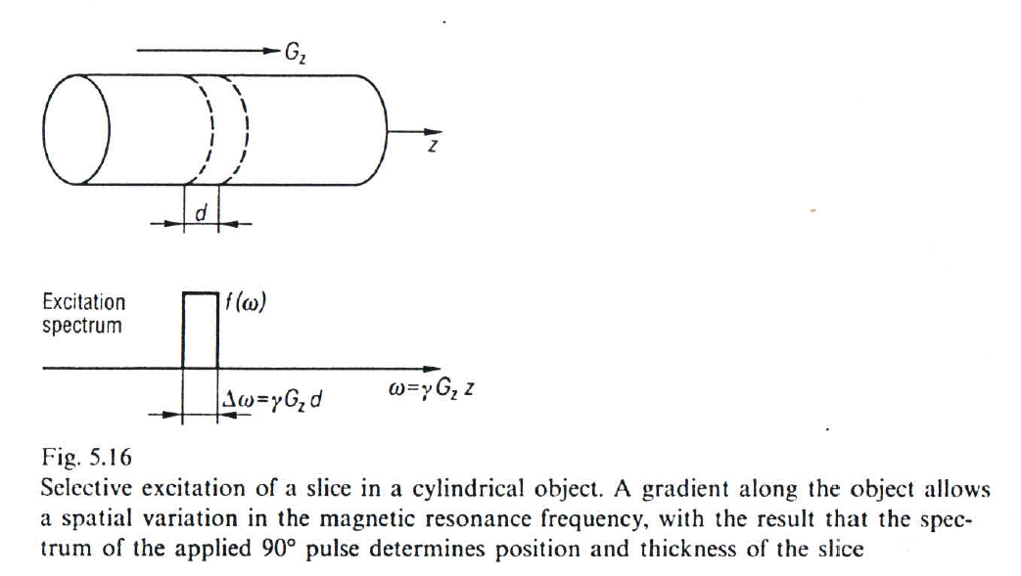
90° pulse selective excitation of a slice

Slide 13
How to excite a slice with finite thickness?
Equation of motion of the spins in the frame rotating with $γB0$ :
$$\frac{1}{γ}\frac{dM}{dt}=M×B1=M0∗B1(t)$$
For small angles ($dα=γB1dt$) of rotation about the axis of the RF-field (B₁) the equation can be approximated with a linearized form:
$$dM⊥=γM0B1\left(t\right)e^{−iωt}dt$$
where $M⊥=Mx+iMy$and$B1(t)e^{−iωt}$ is an amplitude-modulated excitation observed in the rotating frame. Remaining frequency of$ω≪ωL$ is due to the magnetic field gradient: $ω=γGzz$

Slide 14
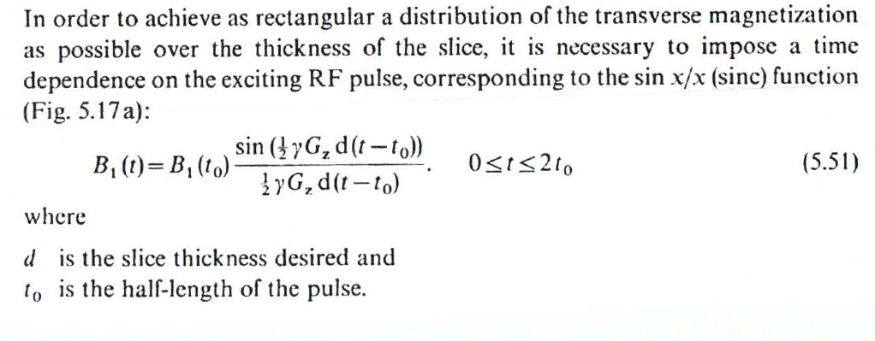
Selective slice excitation wave form
$$M⊥(z)=γ\int_{0}^{tmax}{M0B1(t)e^{−iγGzzt}dt}$$

Slide 15
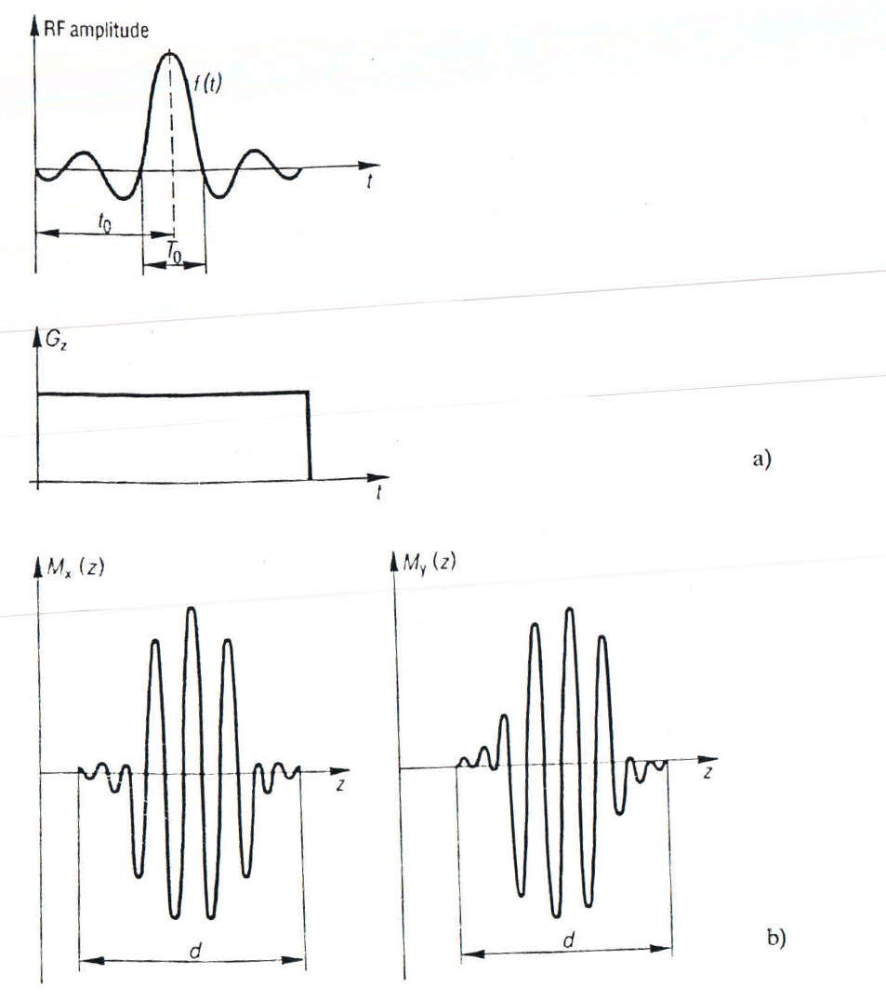
Resulting excitation of the slice
$$M⊥=M0rect(\left|z\right|−\frac{d}{2})e^{iγGzzt0}$$
$$d=4/γGzT0$$
Fig. 5.17
To excite a rectangular slice, the radio frequency of the 90° pulse is modulated with a sinc (sinx/x) function.
x and y magnetization (in the rotating frame) as a function of the slice thickness following selective excitation; the magnetization rotates in a spiral fashion.

Slide 16
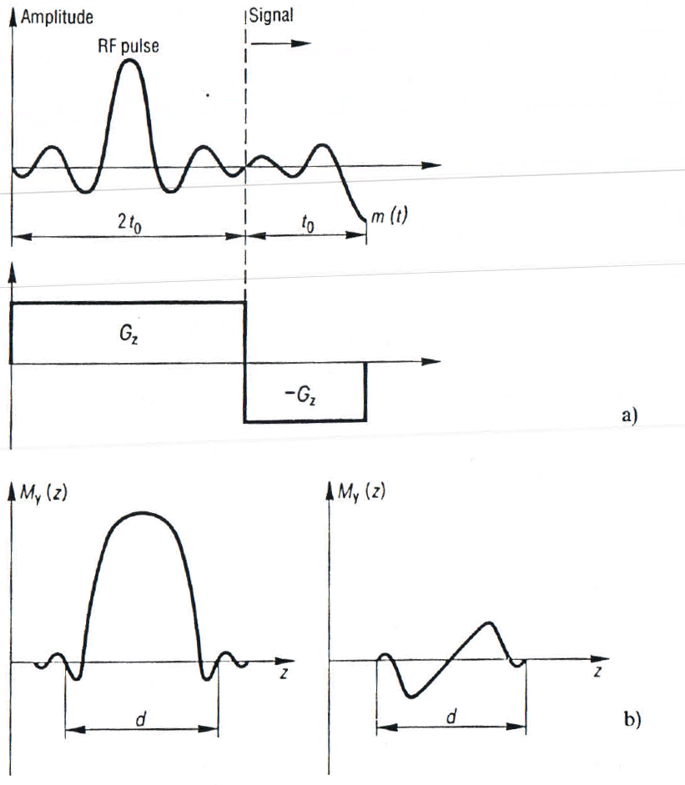
Realigning spins in the slice
Fig. 5.18
In order to realign the transverse magnetization, which rotates after the selective 90 pulse, an interval with a reversed-polarity field gradient is added on after the RF pulse.
X and y magnetization as a function of slice thickness for selective excitation with refocussing. The remaining oscillation is an expression of the non-linearity of the Bloch equations. It can be improved by means of modified RF modulations

